Slide 1

Earthquake Prediction

Slide 2
Earthquake Prediction

Slide 3
Introduction
An earthquake is a weak to violent shaking of the ground produced by the sudden movement of rock materials below the earth’s surface.
The earthquakes originate in tectonic plate boundary. The focus is point inside the earth where the earthquake started, sometimes called the hypocenter, and the point on the surface of the earth directly above the focus is called the epicenter.
There are two ways by which we can measure the strength of an earthquake: magnitude and intensity. Magnitude is proportional to the energy released by an earthquake at the focus. It is calculated from earthquakes recorded by an instrument called seismograph. It is represented by Arabic Numbers (e.g. 4.8, 9.0). Intensity on the other hand, is the strength of an earthquake as perceived and felt by people in a certain locality. It is a numerical rating based on the relative effects to people, objects, environment, and structures in the surrounding. The intensity is generally higher near the epicenter. It is represented by Roman Numerals (e.g. II, IV, IX). In the Philippines, the intensity of an earthquake is determined using the PHIVOLCS Earthquake Intensity Scale (PEIS).

Slide 4
PROBLEM STATEMENT:
Forecasting Earthquake is one of the most important problem in science because of their “CATASTROPHIC” consequence.
The earthquake caused seismic waves to travel through the Earth’s crust. Due to the energy from the seismic waves many buildings were destroyed and the community is still feeling aftershocks.
The total death count is unknown, although, many people are dead and others are injured. The city is a disaster area in need of much work over a long period

Slide 5
PROPOSED SYSTEM:
In Earthquake prediction Machine learning plays a major role. Machine Learning techniques are used to interpret and analyze previous Earthquake readings to find the major factor that causes earthquake. Earthquake can strike any location at any time. But the history shows in same general pattern year after year. If we look at the pattern of where earthquakes occur around the world, it is clear that most of the activity is concentrated in a number of distinct earthquake belts; for instance the edge of the Pacific Ocean, or in the middle of the Atlantic Ocean. Machine learning has been used to predict occurance of earthquake at a place. Based upon Previous earthquake results in india.

Slide 6
HARDWARE REQUIREMENTS:
SOFTWARE REQUIREMENTS :
SCIKIT-LEARN
SPYDER
PYTHON
MATPLOTLIB
JUPYTER
PANDAS
NUMPY
Required ram: 4gb or more
Hard Disk: 30gb of free space Processor: 64 bit, quad-core, 2.5 GHz minimum per core
Display: Dual XGA (1024 x 768) or higher resolution monitors

Slide 7
MODULES INVOLVED IN THE PROJECT
PANDAS
NUMPY
SKLEARN
Mathplotlib
Pyplot
ensemble

Slide 8
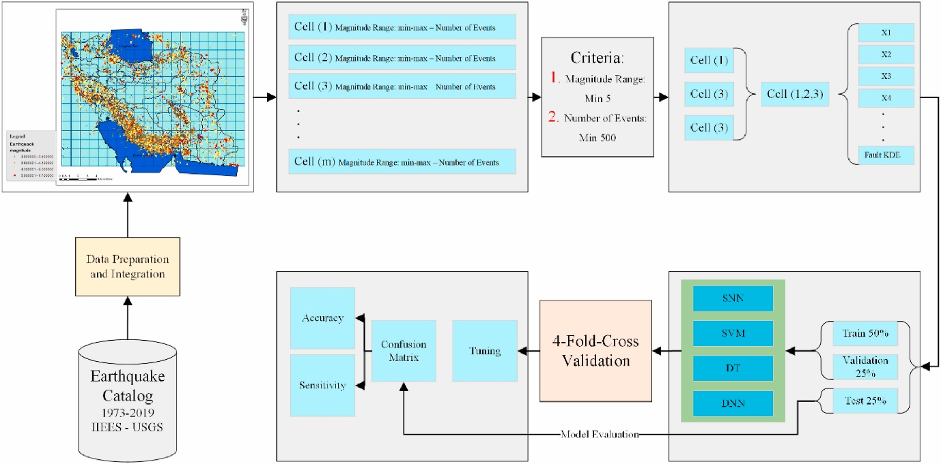
ARCHITECTURE :

Slide 9
MACHINE LEARNING MODELS:
1.MULTI-LINEAR REGRESSION
2.DECISION TREE REGRESSION
3.RANDOM FOREST REGRESSION
4.SUPPORT VECTOR REGRESSION
5.LASSO REGRESSION
.

Slide 10
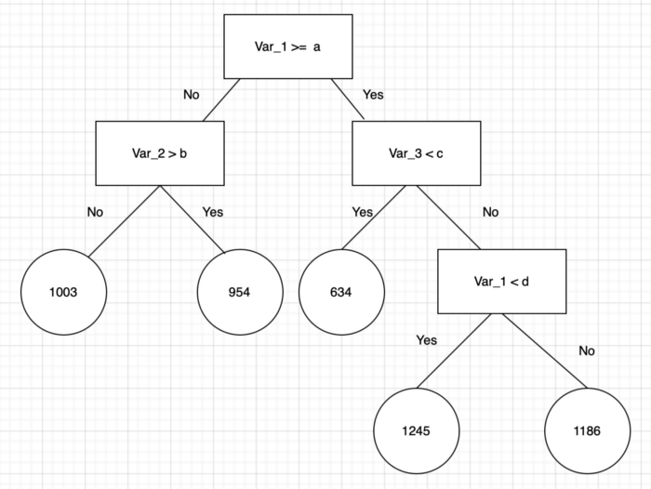
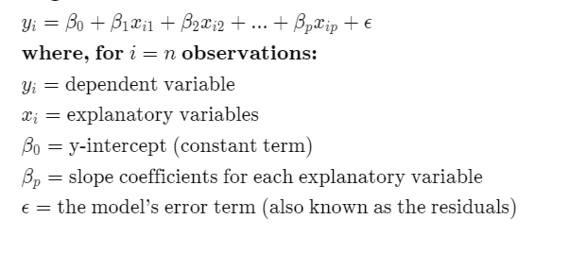
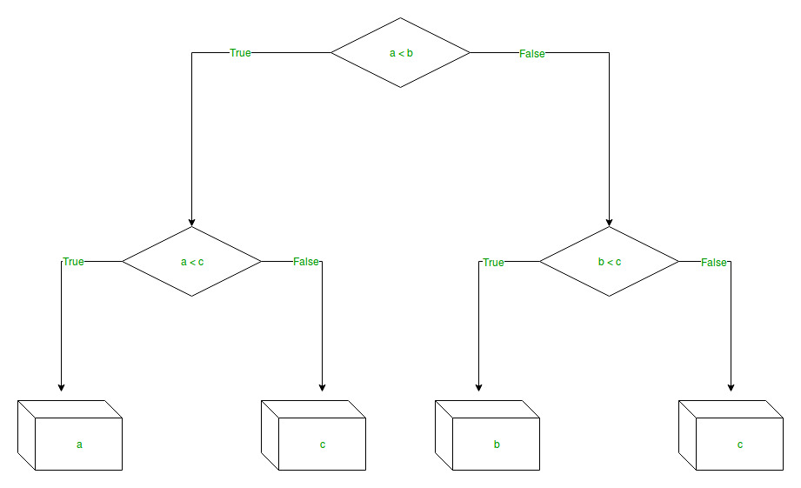
MULTI-LINEAR REGRESSION:
DECISION TREE :
RANDOM FOREST:

Slide 11
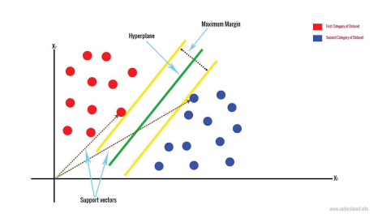

LASSO REGRESSION:
SUPPORT VECTOR :

Slide 12
Testing

Slide 13
Output

Slide 14
CONCLUSION:
As we can see from the above results we have the least error rate and highest R2 score for Random Forest Model. So we will use Random Forest for predicting Earthquake which has highest accuracy rate.
We have proposed a model to predict the earthquake at a location. It is believed that the performance of the model can be improved or the model can give more accurate data if more datasets are available. The model give the results on the basis of data given to it. Thus, forecasting may not be 100% accurate, but it can surely be used as a corrective measure
From the two methods, it can be seen that the accuracy of the two calculations is relatively similar, which is close to 55%. However, the accuracy of manual calculations can be improved by finding the minimum child information gain value from other features such as deep, latitude, and longitude. As for the measures using Google Collab, it can be iterated again to get the highest accuracy

Slide 15
Thanks!
Any questions?

